Slide 1
Java Server Pages
Introduction
A First JSP Example
Implicit Objects
Scripting
Standard Actions
Directives
Database Connectivity
Session Tracking
Exception Handling

Slide 2
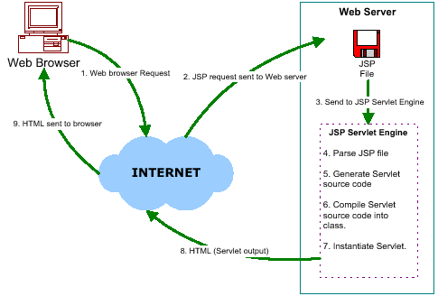
JSP Introduction
As an extension of Servlet technology, JSPs are essential an HTML page with special JSP tags embedded. These JSP tags can contain Java code. The JSP file extension is .jsp rather than .html or .html
Steps required for a JSP request:
The user goes to web side made using JSP. The web browser makes the request via the Internet.
The JSP request gets sent to the Web server.
The Web server recognizes that the file required is special (.jsp), therefore passes the JSP file to the JSP servlet engine
If the JSP file has been called the first time, the JSP file is parsed, otherwise goto step 7.
The next step is to generate a special Servlet from the JSP file. All the HTML required is converted to println statements.
The Servlet source code is compiled into a class.
The servlet is instantiated, calling the init and service methods.
HTML from the Servlet output is sent via the Internet.
HTML results are displayed on the user's web browser.

Slide 3
JSP Introduction (cont.)
Servlets
Used when small amount of content is fixed-template data
Most content generated dynamically
Some servlets do not produce content: invoke other servlets and JSPs
JSPs
Look like standard HTML or XHTML
Normally include HTML or XHTML markup
Known as fixed-template data
Used when content is mostly fixed-template data
Small amounts of content generated dynamically
Use special tags (JSP tags) to include existing Java components OR codes: declaration, expression, directive, scriptlet, action, custom tag library

Slide 4
JSP Introduction (cont.)
Declaration tag (<%! %>)
Allow the developer to declare variables or methods
For Example
<%!
private int counter = 0;
private String getAccount(int accountNo);
%>
Expression tag (<%= %>)
Allow the developer to embed any Java expression and is short for out.println()
For Example
<%= new java.util.Date() %>

Slide 5
JSP Introduction (cont.)
Directive (<%@ directive... %>
Give special information about the page to the JSP container
Enable programmers to specify:
Page settings (page directive)
Content to include from other resources (Include directive)
Tag libraries to be used in the page (Tag library)
Action (<%action... %>
Predefined JSP tags that encapsulate functionality
Often performed based on information from client request
Can be used to create Java objects for use in scriptlets

Slide 6
JSP Introduction (cont.)
Scriptlet (<% ... %>) - also called “Scripting Elements”
Enable programmers to insert Java code in JSPs
Performs request processing
Interacts with page elements and other components to implement dynamic pages
Can access any variable or bean declared.
For example, to print a variable:
<%
String username = “alliant”;
out.println(“username”);
%>
Custom Tag Library
JSP’s tag extension mechanism
Enables programmers to define new tags
Tags encapsulate complex functionality
Tags can manipulate JSP content

Slide 7
A First JSP Example
Simple JSP example
Demonstrates
Fixed-template data (XHTML markup)
Creating a Java object (java.util.Date)
Automatic conversion of JSP expression to a String
First invocation of clock.jsp
Notice the delay while:
JSP container translates the JSP into a servlet
JSP container compiles the servlet
JSP container executes the servlet
Subsequent invocations should not experience the same delay

Slide 8
Using a JSP expression to insert the date and time in a Web page (Part 1). Line 10 Line 30
1 <?xml version = "1.0"?>
2 <!DOCTYPE html PUBLIC "-//W3C//DTD XHTML 1.0 Strict//EN"
3 "http://www.w3.org/TR/xhtml1/DTD/xhtml1-strict.dtd">
4
6
7 <html xmlns = "http://www.w3.org/1999/xhtml">
8
9 <head>
10 <meta http-equiv = "refresh" content = "60" />
11
12 <title>A Simple JSP Example</title>
13
14 <style type = "text/css">
15 .big { font-family: helvetica, arial, sans-serif;
16 font-weight: bold;
17 font-size: 2em; }
18 </style>
19 </head>
20
21 <body>
22 <p class = "big">Simple JSP Example</p>
23
24 <table style = "border: 6px outset;">
25 <tr>
26 <td style = "background-color: black;">
27 <p class = "big" style = "color: cyan;">
28
29 <!-- JSP expression to insert date/time -->
30 <%= new java.util.Date() %>
31
32 </p>
33 </td>
34 </tr>
35 </table>
meta element refreshes the Web page every 60 seconds
Creates Date object that is converted to a String implicitly and displayed in paragraph (p) element

Slide 9
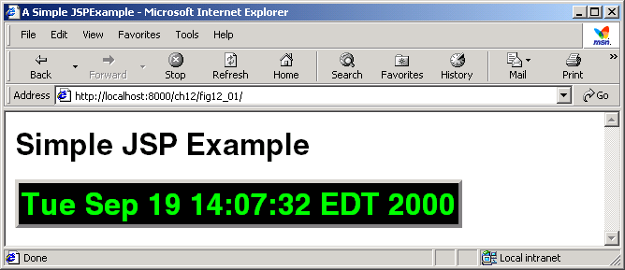

Using a JSP expression to insert the date and time in a Web page (Part 2). Program Output
36 </body>
37
38 </html>
String representation of Date object appears here.

Slide 10
Implicit Objects
Provide access to many servlet capabilities within a JSP.
Extend classes or implement interfaces
Such objects can invoke public aspects of classes/interfaces
All the implicit objects are divided by four variable scopes:
Application:
Objects owned by the container application
Any servlet or JSP can manipulate these objects
Page:
Objects that exist only in page in which they are defined
Each page has its own instance of these objects
Request:
Objects exist for duration of client request
Objects go out of scope when response sent to client
Session:
Objects exist for duration of client’s browsing session
Objects go out of scope when client terminates session or when session timeout occurs

Slide 11
Implicit Objects (cont.)

Slide 12
Implicit Objects (cont.)

Slide 13
Scripting
Scripting
How JSP programmers can insert Java code and logic
Currently, JSP support scripting only with Java
JSP scripting components
Scriptlets (delimited by <% and %>) Comments (delimited by <%-- and --%>) Expressions (delimited by <%= and %>) | Declarations (delimited by <%! and %>) Escape sequences

Slide 14
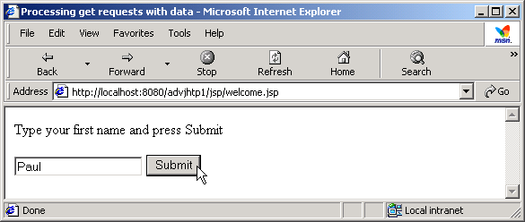
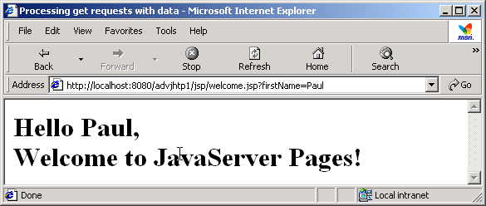
Scripting – Practice 1
Demonstrate basic scripting capabilities that Responding to get requests

Slide 15
Standard Actions 1/2
JSP standard actions
Provide access to common tasks performed in a JSP
Including content from other resources
Forwarding requests to other resources
Interacting with JavaBeans
JSP containers process actions at request time
Delimited by <jsp:action> and </jsp:action>

Slide 16
Standard Actions 2/2

Slide 17
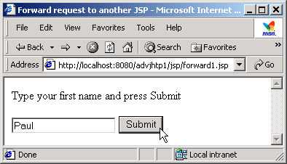
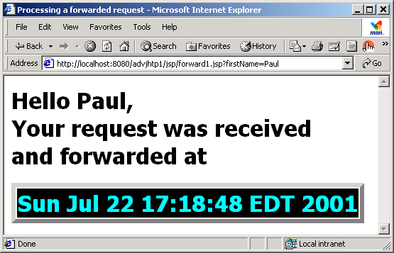
Standard Actions – Practice 2

Slide 18
JSP Directives
Messages to JSP container
Enable programmer to:
Specify page settings
Include content from other resources
Specify custom-tag libraries
Delimited by <%@ and %>

Slide 19

Database Connectivity
Review
Provides a programming interface that is used to request a connection between the application and database
JDBC API executes SQL statements (in the Java code to retrieve data) and sends the results through a single API
Five steps to work with database
Load driver: Class.forName(“sun.jdbc.odbc.JdbcOdbcDriver”);
Create Connection object
Connection con= DriverManager.getConnection(
jdbc:odbc:Datasource, “userid”, “pwd” );
Create Statement: Statement stat = con.createStatement() ;
Execute Query
String query = “Select * from table_name”;
ResultSet resultset = stat.executeQuery(query);
Process Results: next() method of the ResultSet object is used to process the results from the database

Slide 20
Database Connectivity – Sample
<html>
<head>
<title>DB Test</title>
</head>
<body>
<%@ page language="java" import="java.sql.* " %>
<%
try
{
out.println("loading driver...<br>");
Class.forName("sun.jdbc.odbc.JdbcOdbcDriver ");
out.println("connecting...<br>");
Connection con= DriverManager.getConnection(jdbc:odbc:Datasource, "userid ", "pwd ")
out.println("querying database...<br>");
Statement stat = con.createStatement();
String query = "Select * from table_name ";
ResultSet rs = statement.executeQuery(query);
Importing Java.sql.* package
Loading the driver
Creating Connection object
Creating Statement
Executing the query

Slide 21
Database Connectivity – Sample
while (rs.next())
{
out.println(rs.getString(1)+ "<br>");
}
rs.close();
Stat.close();
c.close();
}
catch(Exception e)
{
out.println("ERROR! "+e.getMessage());
}
%>
</body>
</html>
Processing results
Closing connections
Catch exception and display error message

Slide 22
Session Tracking
Maintains a session till the user is browsing the Web site
Used in interactive Web applications to store the information of the user logged in to the Web site
The information stored is used to identify the user sending a request to the Web server
Session tracking helps to maintain the session information and keeps track of the multiple requests made by the client
HTTP – stateless protocol
Does not support persistent information
Track clients individually
Cookies
Session tracking
hidden type input
URL rewriting

Slide 23
Session Tracking - Cookies
Cookies are text files stored on the user’s computer containing the session Id of the user sent by the Web server
The cookie is sent back to the Web server with every subsequent request made by the user in the same session
The cookie includes a name, a single value and optional attributes
Deleted automatically when they expire
Servlet CookieServlet
Handles both get and post requests

Slide 24
Session Tracking – Cookies (cont.)
Advantages
Remember user IDs and password.
To track visitors on a Web site for better service and new features.
Cookies enable efficient ad processing.
Disadvantages
The size and number of cookies stored are limited.
Personal information is exposed to the other users.
Cookies fails to work if the security level is set too high in the Internet browser.

Slide 25
Session Tracking - How Do We Need HTTP State?
Web applications need to track the users across a series of requests:
Online shopping (e.g. Order books)
Financial portfolio manager
Movie listings
HTTP does not support directly
Need a mechanism to maintain state about a series of requests from the same user ( or originating from the same browser) over some period of time

Slide 26
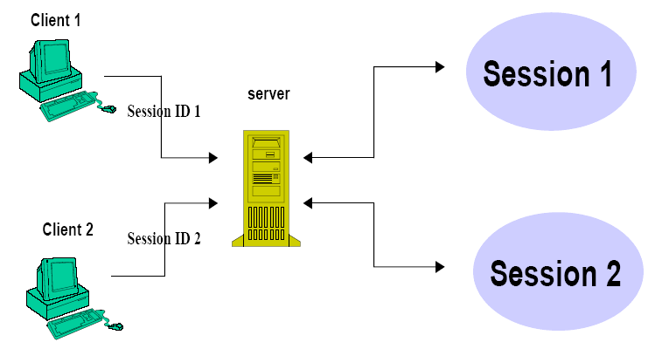
Session Tracking with HttpSession
The servlet API has a built-in support for session tracking
Session objects live on the server
Each user has associated an HttpSession object—one user/session
HttpSession object operates like a hashtable

Slide 27
Session Tracking with HttpSession Session Life Cycle
The server assigns a unique ID to the session created for a particular user request.
This session ID is passed to the client as a cookie or a hidden variable.
The session is considered new until the client returns the session ID to the server through a cookie or as a part of the requested URL.
A session exists on the server until it becomes invalid or the server is stopped.
The HttpSession objects are used to store the session data in the current servlet context.

Slide 28
Session Tracking with HttpSession Using Session Object
Session object can be used to store and read data.
The session object acts almost like a bulletin board from where the objects can be written or read

Slide 29
Session Tracking with HttpSession Using Session Object (cont.)
The request() method requests for the session object.
…
…
// Obtain a session object
HttpSession session = request.getSession(true);
//Add an item to the session
Integer sessionData = new Integer (100);
Session.putValue(“IntValue”, sessionData);
…
…
Obtains a session object
Adds item to the session object

Slide 30
Session Tracking with HttpSession Using Session Object (cont.)
The session value can be read and cast to the appropriate object type.
…
// Obtain a session object
HttpSession session = request.getSession(true);
// Read the session data and cast it to the appropriate object type
Integer sessionInt = (Integer) session.getValue(“session”);
int count = sessionInt.intValue();
…
…
Obtains a session object
Reads the session value
Casts the session value to appropriate datatype

Slide 31
Session Tracking with HttpSession Using Session Object (cont.)
The session can be invalidated using the invalidate() method of the HttpSession object.
<%
String sessionval=(String)session.getAttribute("userid"));
if(sessionval == null)
{
session.setAttribute("userid",sessionval);
out.println(session.getAttribute("userid"));
}
else
{
out.println("User Session already created");
}
%>
<b>click this link to
<a href="<%=session.removeAttribute("userid")%>">remove session attribute</a></b><br/>
<b>click this link to <a href="<%=session.invalidate()%>"> invalidate the session</a></b><br/>
Accepts userid
If sessionval is null, the value of sessionval is set to userid.
Removes the session
Invalidates the session

Slide 32
Session Tracking with HttpSession Using Session Object (cont.)
To get a user's existing or new session object:
HttpSession session = request.getSession(true);
"true" means the server should create a new session object if necessary
To store or retrieve an object in the session:
Stores values: setAttribute("cartItem", cart);
Retrieves values: getAttribute("cartItem");

Slide 33
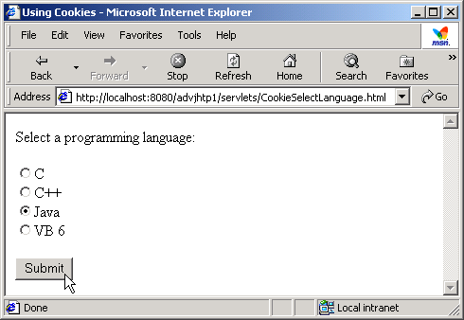
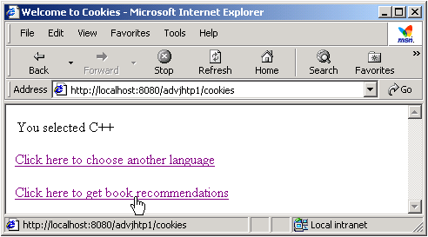
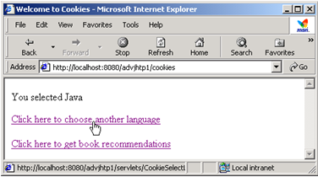
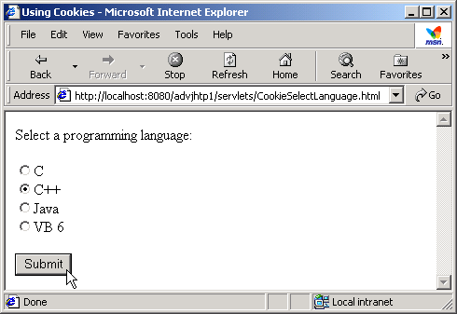
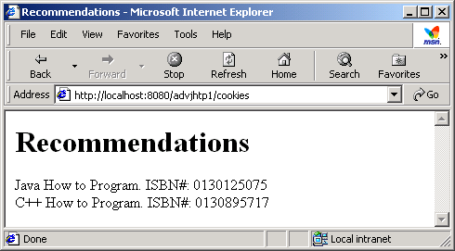
Session Tracking - Practice 3

Slide 34
Session Tracking - URL Rewriting
JSP hides the details of a cookie-based session tracking and supports the URL rewriting mechanism
URL Rewriting works with Web browsers that do not support cookies or the cookies that are disabled on a Web browser
Each URL that references the Web browser is returned to the user and contains additional information

Slide 35
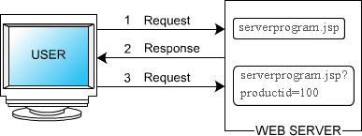
Session Tracking - URL Rewriting (cont.)
The session ID is encoded in the URLs that are created by the JSP pages

Slide 36
Session Tracking - URL Rewriting (cont.)
<b>Search results for books</b> <form method="post" action="serverprogram.jsp"> <input type="checkbox" name="productID" value="100">CD MP3 Converter Kit For Your CAR<br> <input type="checkbox" name="productID" value="101">Front Loading Car MP3/CD Player With Anti Shock Memory and FM<br>
<input type="checkbox" name="productID" value="102">CAR/Home DVD/VCD/MP3 Playerwith anti shock for Indian Roads<br> <input type="submit" name="Submit" value="Add to Cart"><br> </form>
URL of server side program
Provides check box for different products
Submits the user input to URL

Slide 37
Session Tracking - URL Rewriting (cont.)
<b>Search results for books</b> <form method="post" action="serverprogram.jsp?productID=102">
<input type="checkbox" name="productID" value="150">DVD Player with built in Amplifier <br> <input type="checkbox" name="productID" value="160">Ultra Slim DVD Player Multi Region 5.1 Digital<br> <input type="submit" name="Submit" value = "Add to Cart">
<br> </form>
URL for server side program after the user selects a product and goes to another page
Provides check box for different products
Submits input to the URL

Slide 38
Session Tracking - URL Rewriting (cont.)
Disadvantages
Server side processing is tedious.
Every URL that is returned to the user should have additional information appended to it.
If the user leaves the session and opens the Web page using a link or bookmark then the session information is lost .

Slide 39
Session Tracking – Hidden Form Fields
Information from the Web browser is returned to the Web server in the form of HTTP parameters
Utilizes the hidden fields in an HTML page
Hidden fields in the form are used to send the information to the Web browser
Stores information about a session
Helps to carry the information from one HTML page to another

Slide 40
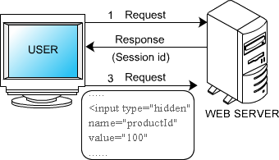
Session Tracking – Hidden Form Fields (cont.)
When the user visits the next page, the server side program reads all the parameters that a user passes in the previous form

Slide 41
Session Tracking – Hidden Form Fields (cont.)
<b>Search results for books</b>
<form method="post" action="serverprogram.jsp">
<input type="hidden" name="productID" value="100">
<input type="checkbox" name="productID" value="150">DVD Player with Built in Amplifier <br> <input type="checkbox" name="productID" value="160">Ultra Slim DVD Player Multi Region 5.1 Digital<br>
<input type="submit" name="Submit" value="Add to Cart"><br> </form>
Hidden input field
Provides check box for user input
Submits user input to the server side program

Slide 42
Session Tracking – Hidden Form Fields (cont.)
The advantages of hidden form fields are:
Simplest way to implement session tracking
Displays nothing on the HTML page but can be used to hold any kind of data
Helps to maintain a connection between two pages
The disadvantage of hidden form fields is that this method of session tracking displays sensitive information to the user.
The information includes the data passed around to maintain a session.

Slide 43
Exception Handling
Exceptions are errors that can occur in a JSP page
The JSP page traps and handles request time errors
Unhandled exceptions are forwarded to the error page
Syntax
<%@ page errorPage=“errorpage.jsp” %>
Set the isErrorPage attribute of page directive to true, to make a JSP page an error handler
Syntax
<%@ page isErrorPage=“true” %>

Slide 44
Exception Handling - Cont…
Translation time - Occurs when the JSP source file is converted to servlets class file. The JSP engine handles translation time errors.
Request time - Occurs during the processing of the request. Request time errors are the runtime errors that throw exceptions.
<html>
<body>
<%@ page isErrorPage="true" %>
Detected Error: <br>
<%= exception.getMessage() %>
</body>
</html>
Makes JSP page an error handler
Returns error message
Code Snippet to create an error page

Slide 45
Exception Handling - Cont…
<%@ page errorPage="errorpage.jsp" %>
<%
if (request.getParameter("param ").equals("value "))
{
// code
}
//The test above will throw a NullPointerException if param is
// not part of the query string. A better implementation is:
if ("value".equals(request.getParameter("param ")))
{
// code
}
%>
Forwards the unhandled exception to errorpage.jsp
Code Snippet to transfer control to the error page

Slide 46
Q & A

